Slide 1
Superstore Sales Overview
Sales Insights by Category, Region, and Month
Date: June 7, 2025
Presented By Shaik Kashifa Misba Date: June 7, 2025

Slide 2
Executive Summary
- Total Sales: $8.95M
- Highest Sales Category: Technology
- Strongest Region: Central
- Monthly trend shows a sales peak in November

Slide 3
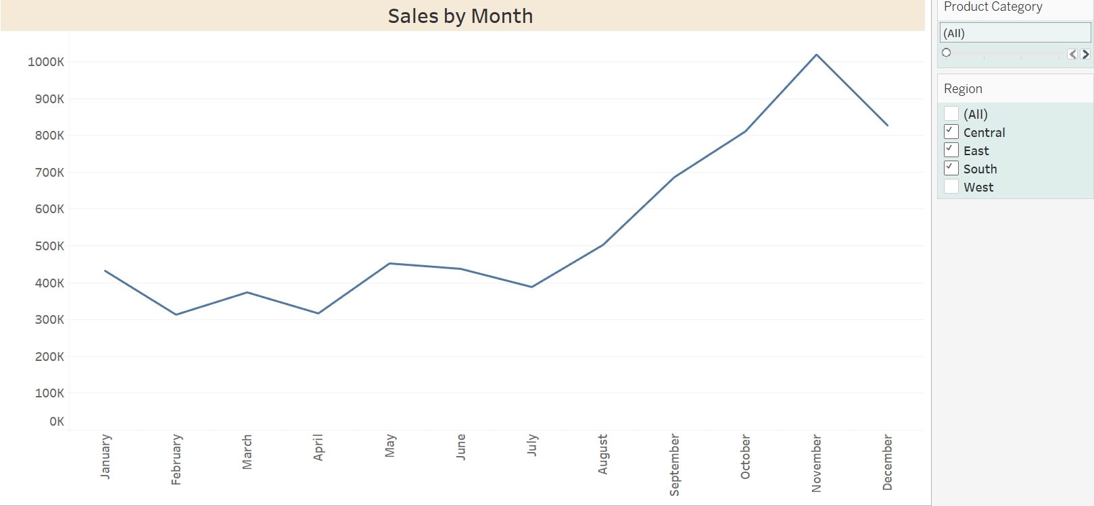
Monthly Sales Trend
Key Insight:
- Steady growth with a peak in November
- Slight drop in December

Slide 4
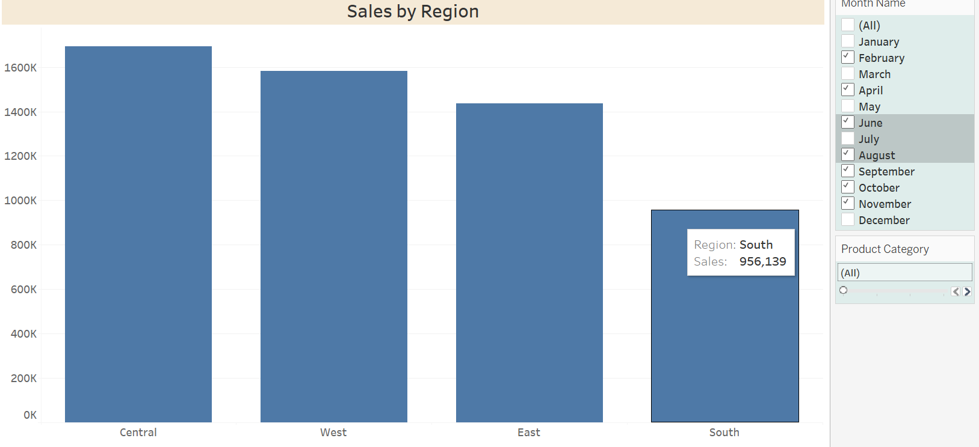
Sales Distribution by Region
Key Insights:
- Central and West outperform other regions
- South region underperforms

Slide 5
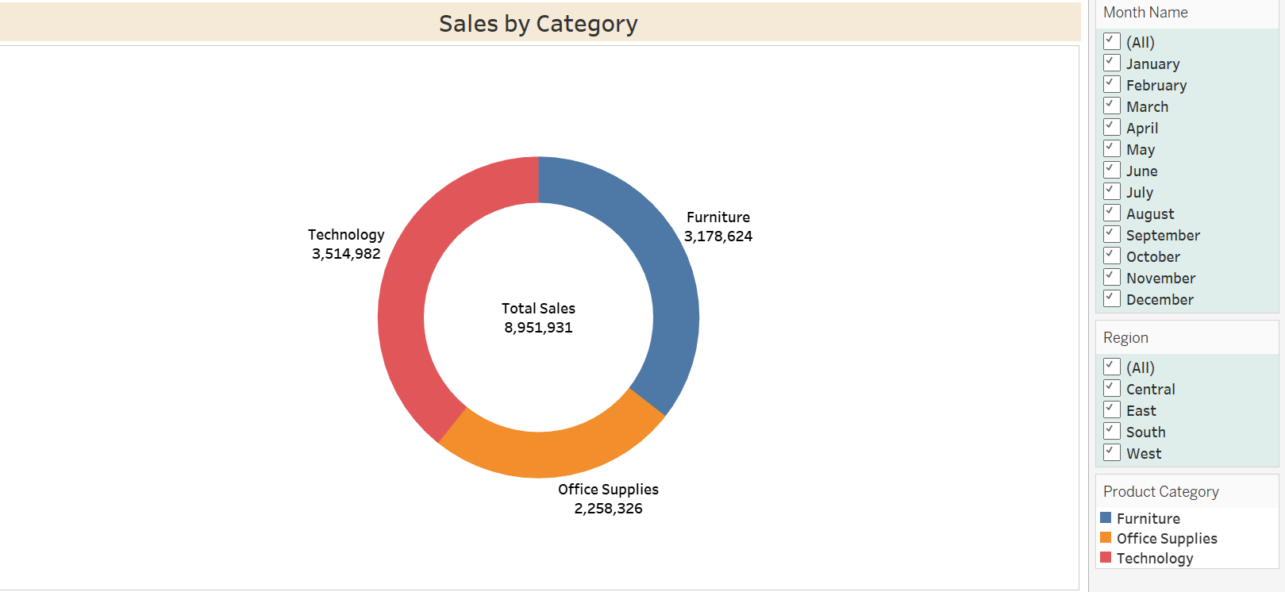
Category-wise Sales Breakdown
Stats:
- Technology: $3.5M
- Furniture: $3.18M
- Office Supplies: $2.25M
Total Sales: $8,951,931

Slide 6
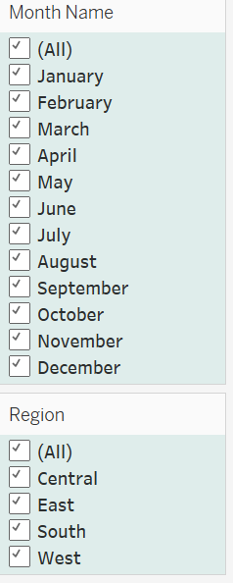
Dashboard Filters
- Region and Month filters allow dynamic analysis
- Example shown: Region = East, Months = April, May, Oct, Nov, Dec

Slide 7
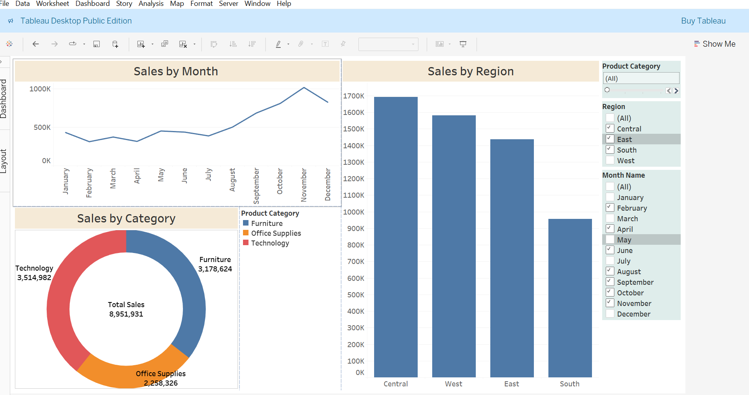
Dashboard Overview

Slide 8
Key Takeaways
- Technology is the top revenue driver
- East region needs attention despite high potential
- Opportunity to boost Office Supplies category
- Focus marketing in months with dips (e.g., June–August)

Slide 9
Thank you !!
shaikkashifamisba@gmail.com

